Slide 1



airline
View in Power BI
Last data refresh:
7/6/2022 9:25:43 PM UTC
Downloaded at:
7/6/2022 10:17:14 PM UTC

Slide 2
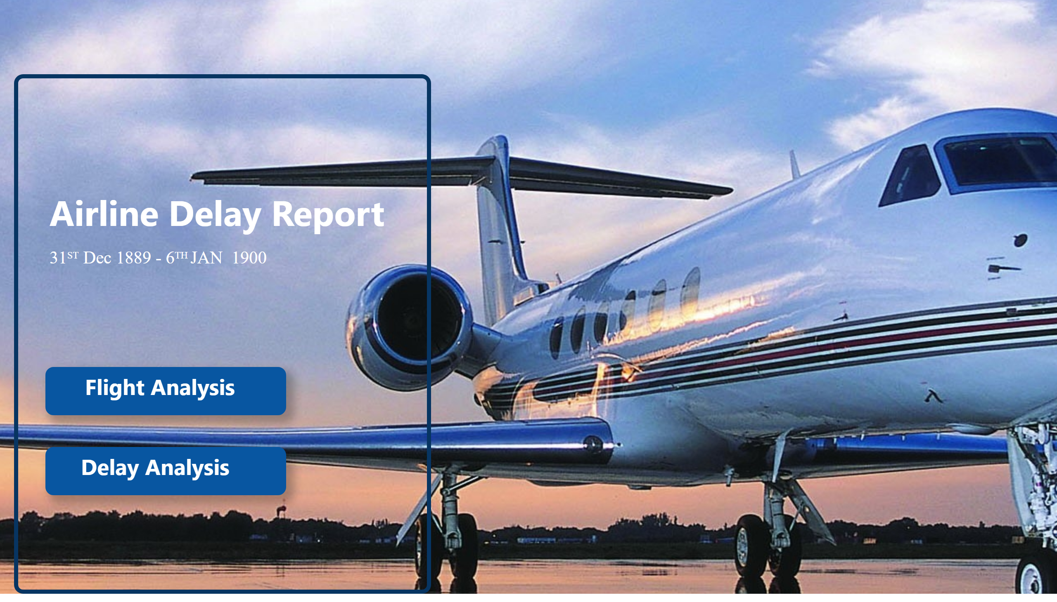
Home
Notes:
shape
No alt text provided
textbox
No alt text provided
textbox
No alt text provided
textbox
No alt text provided
actionButton
No alt text provided
textbox
No alt text provided
actionButton
No alt text provided

Slide 3
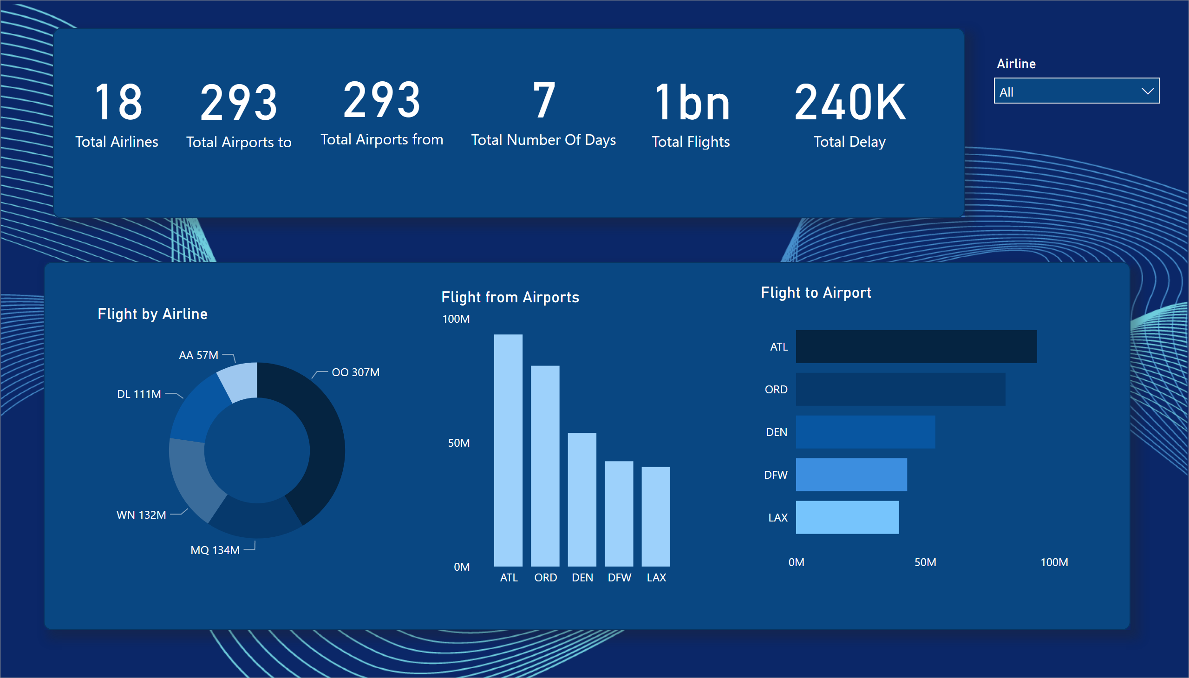
Flight Analysis
Notes:
slicer
No alt text provided
donutChart
No alt text provided
Flight from Airports
No alt text provided
Flight to Airport
No alt text provided
shape
No alt text provided
card
No alt text provided
card
No alt text provided
card
No alt text provided
card
No alt text provided
shape
No alt text provided
card
No alt text provided
card
No alt text provided

Slide 4
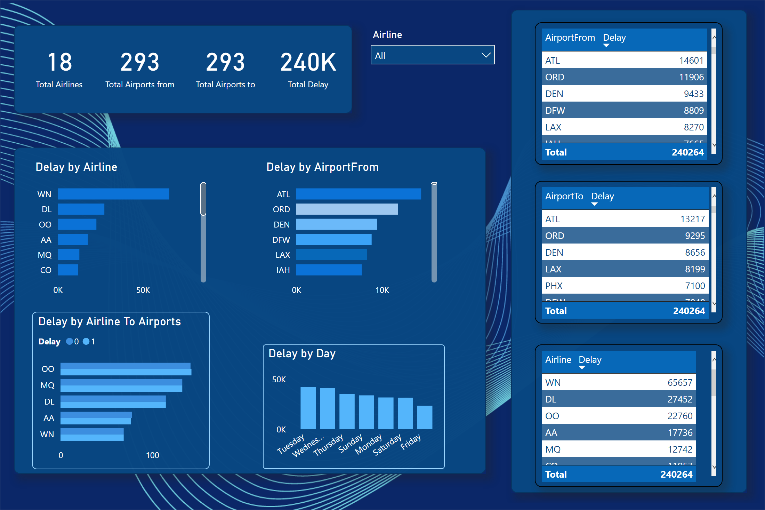
Delay Analysis
Notes:
Delay by Airport to
No alt text provided
clusteredBarChart
No alt text provided
card
No alt text provided
card
No alt text provided
card
No alt text provided
shape
No alt text provided
columnChart
No alt text provided
shape
No alt text provided
shape
No alt text provided
Delay by Airline To Airports
No alt text provided
card
No alt text provided
clusteredBarChart
No alt text provided
Delay by Airport to
No alt text provided
Delay by Airport to
No alt text provided
slicer
No alt text provided

Slide 5
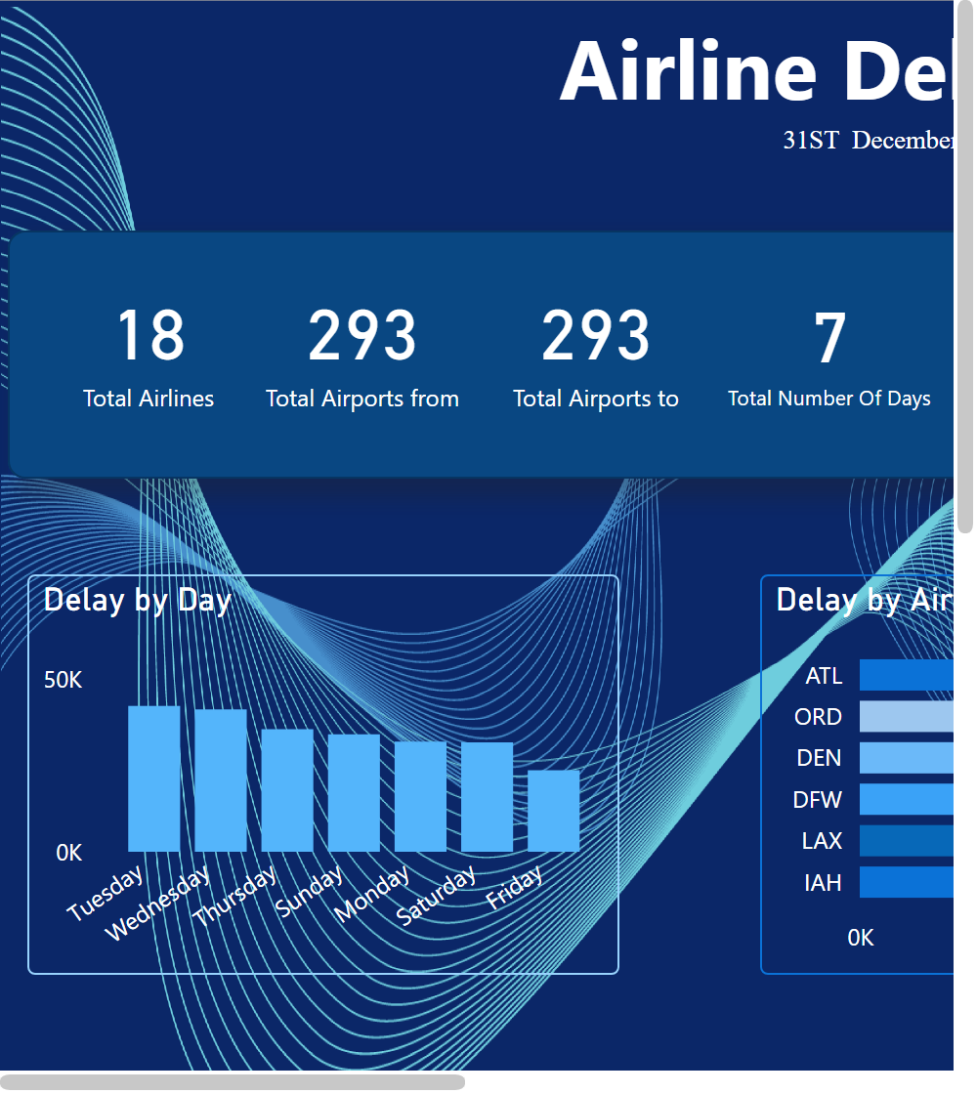
Dashboard
Notes:
textbox
No alt text provided
Delay by Airport to
No alt text provided
Delay by Airport to
No alt text provided
Delay by Airport to
No alt text provided
card
No alt text provided
card
No alt text provided
card
No alt text provided
card
No alt text provided
card
No alt text provided
card
No alt text provided
shape
No alt text provided
clusteredBarChart
No alt text provided
columnChart
No alt text provided
clusteredBarChart
No alt text provided
slicer
No alt text provided
Delay by Airport to
No alt text provided
clusteredBarChart
No alt text provided
slicer
No alt text provided

